Slide 1


A Filmmaker's Guide
By:
Omar Mohamed Omar

Slide 2

Agenda
Project Description​
Objective
Goal
Step by step project creation
Project results
Genres
Language
Director
Actor
Budget
Recommendation

Slide 3

Project Description​
This project involves a comprehensive analysis of the top 250 highest-rated films on IMDb to identify essential factors that contribute to a film's success. By examining a wide range of data from these films.

Slide 4

Objective
The objective of this project is to analyze and identify key factors that contribute to the success of films by examining data from the top 250 highest-rated films on IMDb

Slide 5

Goal
The goal of the project is uncovering patterns and insights that can guide filmmakers in their creative and business decisions, based on historical data extracted from top 250 highest-rated films on IMDb such as (genre, language, director, actor, budget)

Slide 6
Step by step project creation
Obtain the data from IMDb
Cleaning the data.
Removing unwanted characters and Split consistent column.
Explore the data.
Preprocess the data.
Generate a calculated column (Contract, Profit, ROI, Budget Range).
Making binary mapping to used consistent column in the project.
Find the insights and visualize the result

Slide 7
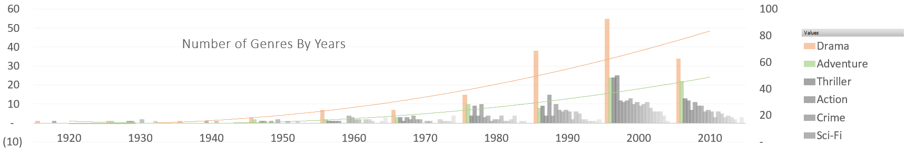
1. Select the genre of film

Slide 8
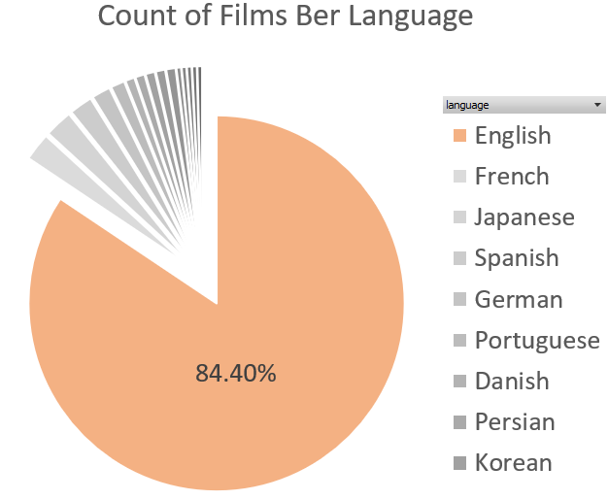
2. Select the language of film

Slide 9
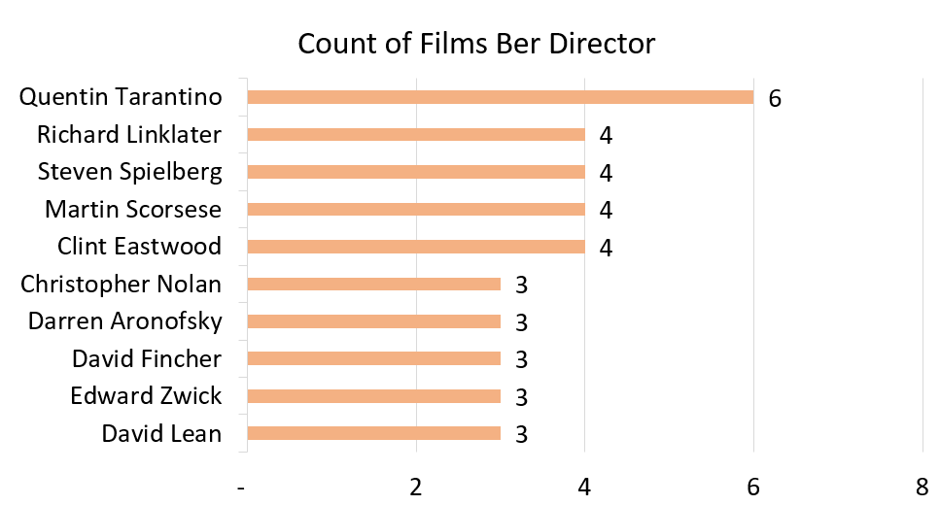
3. Select the director of film

Slide 10
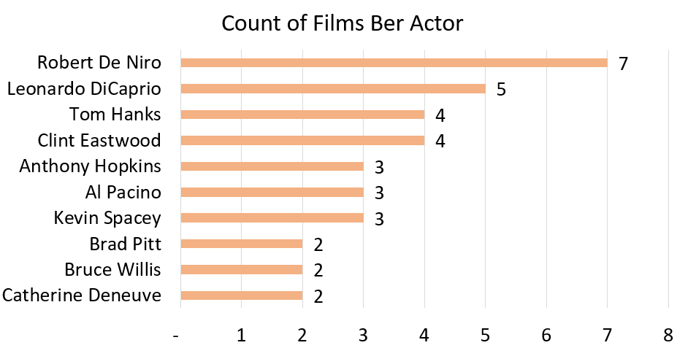
4. Select the actor of film

Slide 11
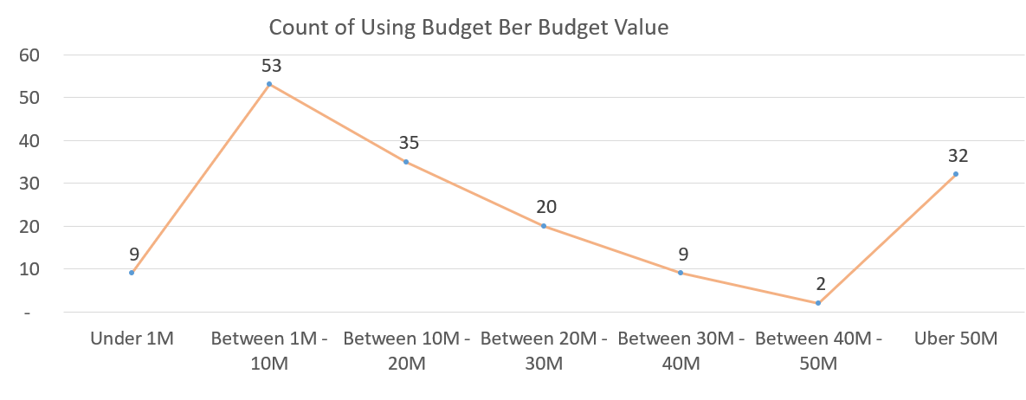
5. Select the budget of film

Slide 12
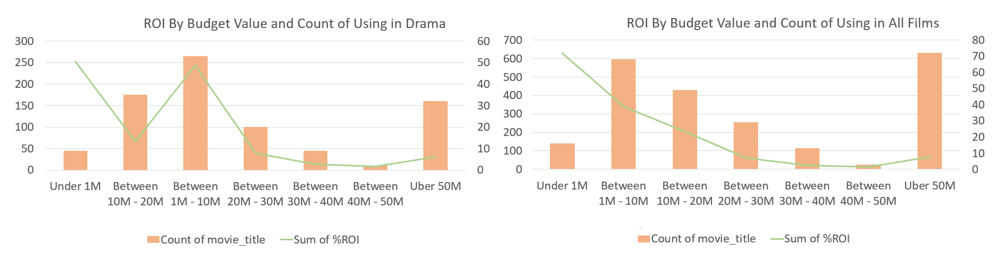
5. Select the budget of film

Slide 13
Recommendation
Recommendation depends on the data to achieve success
Choose the drama genre
Choose the English language
Choose “Quentin Tarantino” as director
Choose “Robert De Niro” or “Leonardo Dicapriois” as actor
Choose film budget between 1 million and 10 million

Slide 14

Thank you

